Slide 1


DIGITAL PORTFOLIO
STUDENT NAME: FAHIZA FALAK V
REGISTER NO AND NMID: ASTVU37537524U18002
DEPARTMENT: BSC COMPUTER SCIENCE
COLLEGE:TAW COLLEGE FOR WOMEN

Slide 2
PORTFOLIO WEBSITE
A PERSONAL PORTFOLIO WEBSITE TO SHOWCASE MY ACADEMIC AND PROFESSIONAL JOURNEY
ACTS AS A DIGITAL RESUME ACCESSIBLE WORLDWIDE
HIGHLIGHTS SKILLS, PROJECTS, AND ACHIEVEMENTS IN A STRUCTURED FORMAT
DESIGNED WITH RESPONSIVE UI FOR ACCESSIBILITY ON DESKTOP AND MOBILE
PROVIDES EASY NAVIGATION THROUGH SECTIONS LIKE ABOUT, SKILLS, PROJECTS, AND CONTACT
INTEGRATED WITH GITHUB AND SOCIAL MEDIA LINKS FOR NETWORKING
SERVES AS A BRANDING TOOL TO ESTABLISH PROFESSIONAL ONLINE PRESENCE

Slide 3

AGENDA
PROBLEM STATEMENT
Project Overview
End Users
Tools and Technologies
Portfolio Design and Layout
Features and Functionality
Results and Screenshots
Conclusion
GitHub Link

Slide 4
PROBLEM STATEMENT
In today’s competitive environment, having a professional digital presence is essential.
Many students and professionals lack a structured platform to:
Showcase their skills and projects
Highlight achievements
Build credibility and networking opportunities

Slide 5
PROJECT OVERVIEW
THE PROJECT IS A PERSONAL PORTFOLIO WEBSITE DESIGNED TO:
PRESENT MY ACADEMIC BACKGROUND AND SKILLS
SHOWCASE COMPLETED PROJECTS WITH DESCRIPTIONS AND TECHNOLOGIES USED
PROVIDE A CONTACT SECTION FOR NETWORKING AND COLLABORATION

Slide 6
END USERS
Recruiters & Hiring Managers – to evaluate skills and projects
Peers & Collaborators – to explore collaboration opportunities
Clients – to check technical expertise and past work
Personal Branding – to create an online identity

Slide 7
TOOLS AND TECHNOLOGIES
Frontend: HTML, CSS, JavaScript
Backend: Python (for data visualization project integration)
Design Tools: Canva
Version Control: Git & GitHub
Video Editing Tools: [Mention tool used, e.g., Adobe Premiere/Filmora]

Slide 8

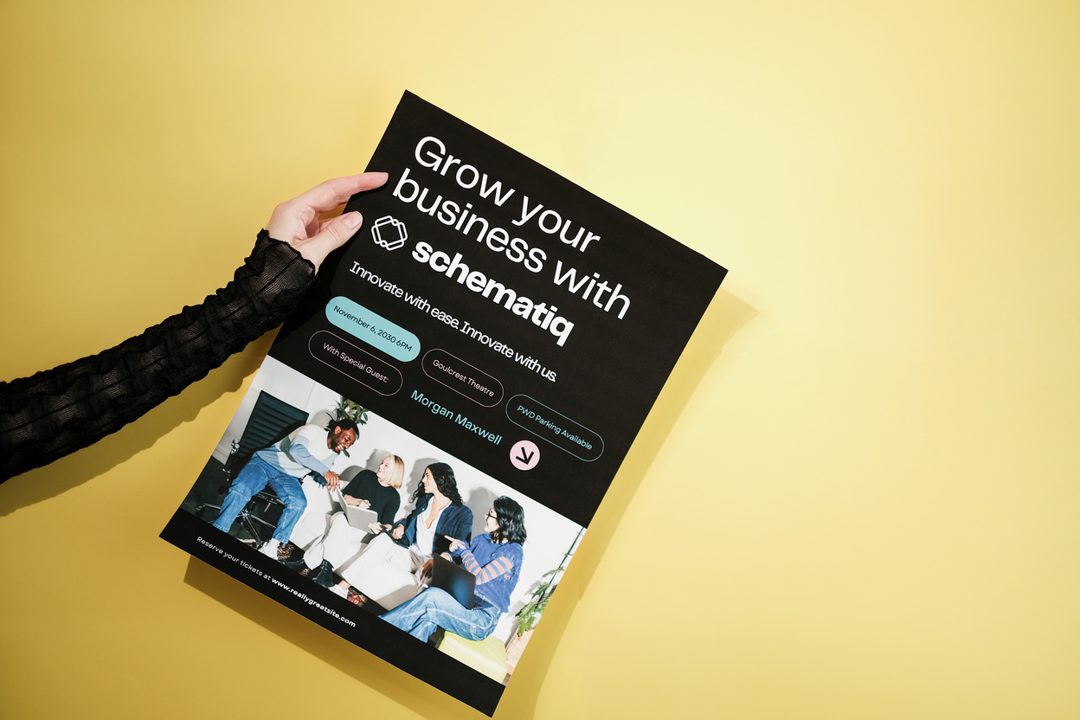


PORTFOLIO DESIGN AND LAYOUT
Sections: Home, About, Skills, Projects, Contact
Design: Clean, modern UI with responsive design
Colors & Fonts: Professional palette with emphasis on green highlights
Layout: Grid-based with interactive elements

Slide 9
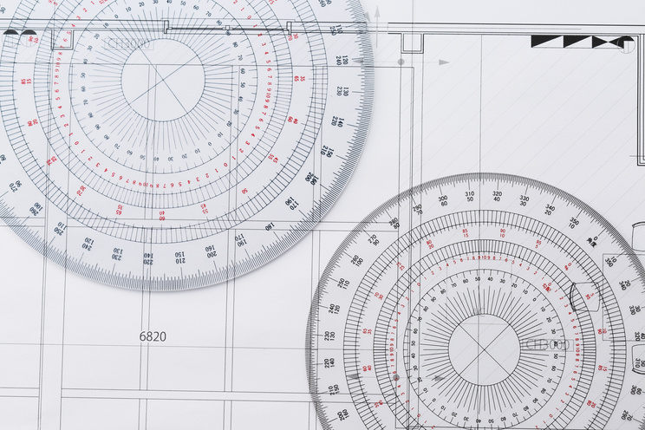

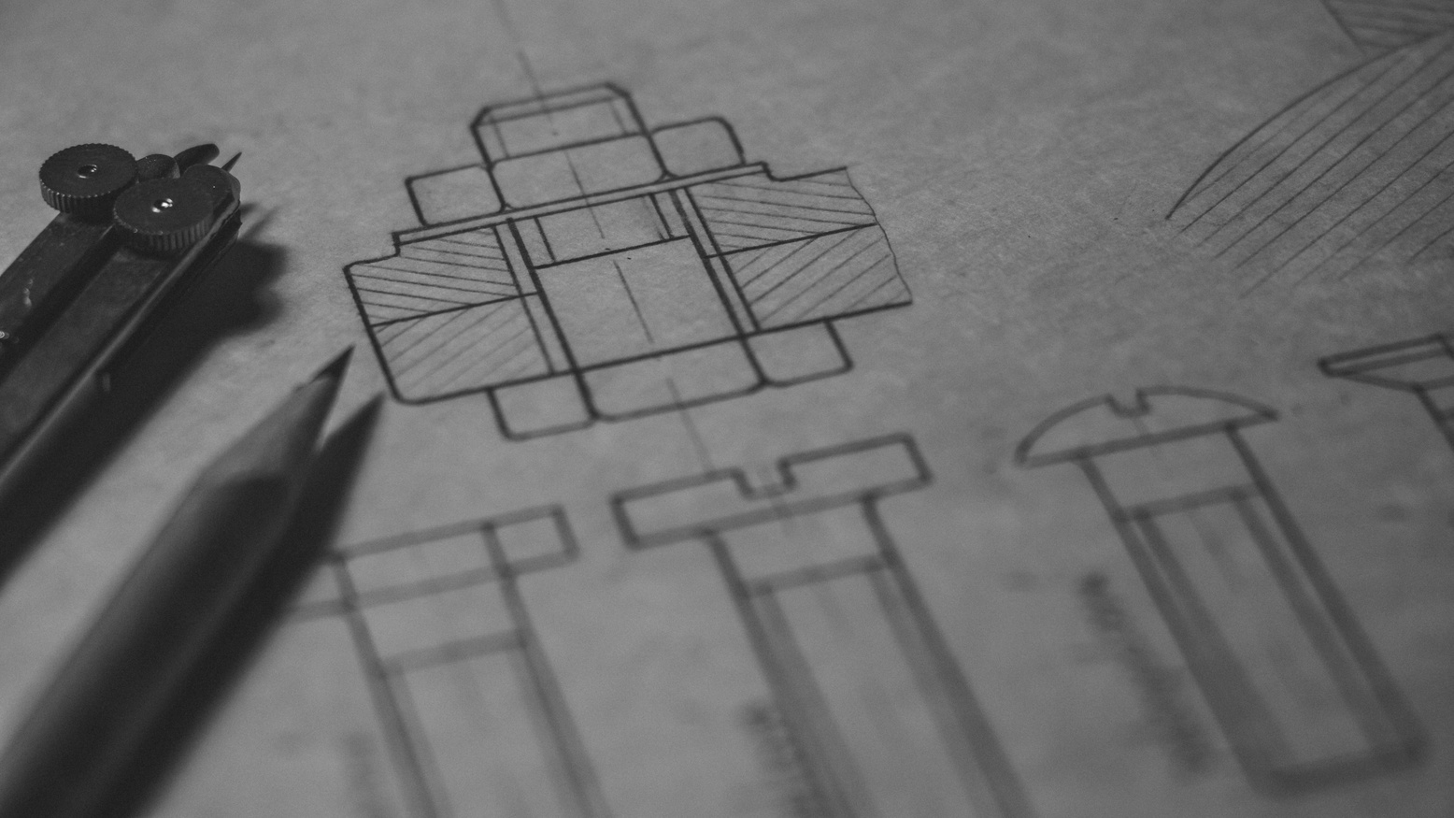

FEATURES AND FUNCTIONALITY
About Me Section: Introduction, education, and experience
Skills Section: HTML, CSS, JavaScript, Python, Video Editing, Canva Design
Projects Section:
E-commerce Website
Data Visualization Tool
Brand Video Campaign
Contact Form: Integrated form for direct communication
Social Media Links: Easy connectivity

Slide 10
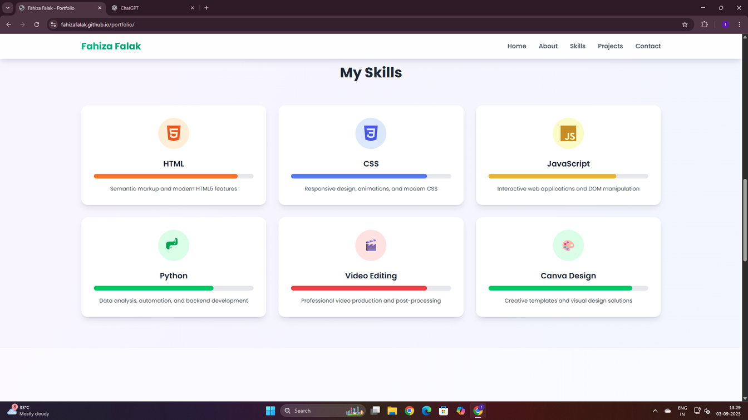
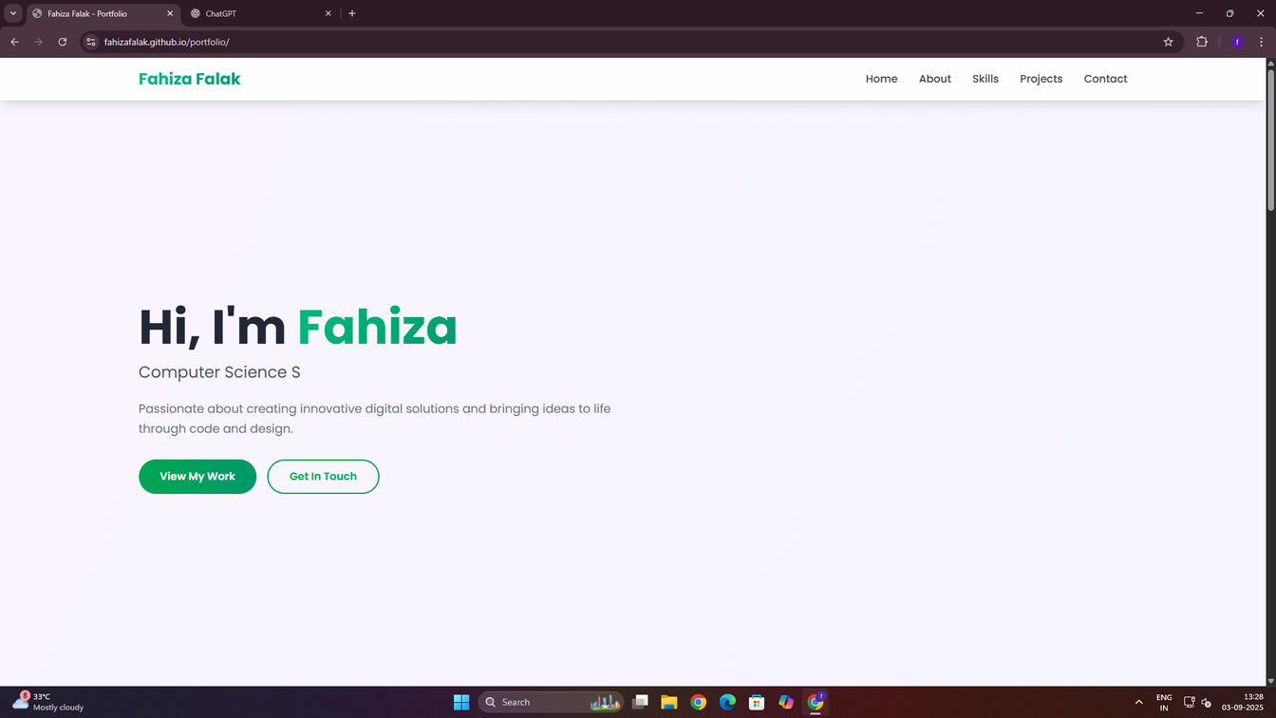
RESULTS AND SCREENSHOTS
A live, fully responsive portfolio website
Showcases projects with detailed descriptions
Professional UI/UX for easy navigation
Provides recruiters and collaborators with a direct way to connect

Slide 11
CONCLUSION & GITHUB LINK
A well-structured digital portfolio to showcase skills, projects, and achievements
Helps in building a professional online presence
Supports career opportunities and collaborations
👉 GitHub Link: https://fahizafalak.github.io/portfolio/

Slide 12
THANK YOU

